Slide 1
Lambda Expression
Name: Minh Nguyen
Company: KMS Technology

Slide 2
Issue of Null Pointer Exception
An example to see the dangers of null
Assume that, we want to get address of customer of one Person by following way:
String projectName = staff().getProject() .getProjectName();
=> If getProject() function returns null, what happen?
Staff
Project

Slide 3
Add checks to prevent null dereferences
String projectName = “UNKOWN”;
If (staff != null) {
Project project = staff. getProject ();
If (project != null) {
projectName = project.getProjectName();
}
}
return projectName ;
Disadvantage: We need a lot of boilerplate code to make sure we don't get a NullPointerException

Slide 4
Groovy have a safe navigation operator (http://www.groovy-lang.org/operators.html#_safe_navigation_operator):
String projectName = staff?.getProject()?.getProjectName() ;
Haskell includes a Maybe type, which essentially encapsulates an optional value. A value of type Maybe can contain either a value of a given type or nothing.
Scala has a similar construct called Option[T] to encapsulate the presence or absence of a value of type T

Slide 5
Java SE 8 introduces a new class called java.util.Optional<T> that is inspired from the ideas of Haskell and Scala. It is a class that encapsulates an optional value.
Optional<Staff>
Optional<Staff>
Staff
Contains object of type Staff
An empty Optional

Slide 6
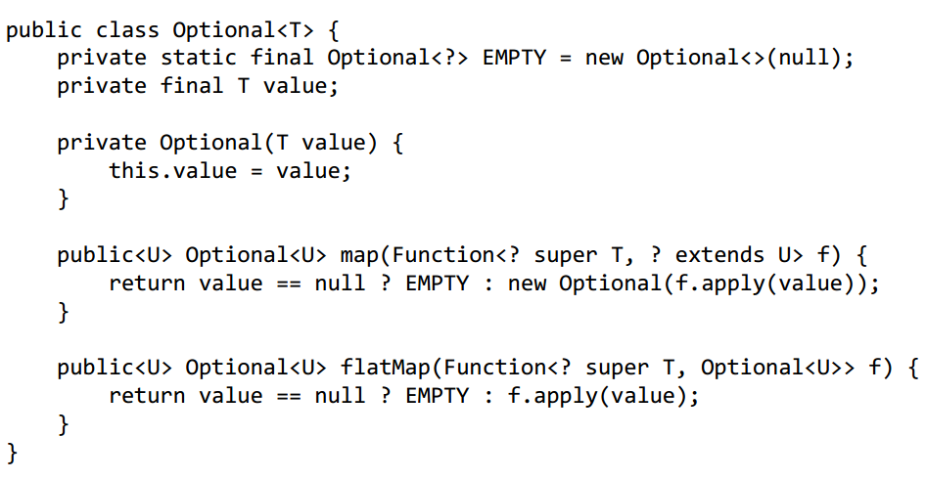

Slide 7
public class Staff { private String id; private Optional<Project> project; public Staff(@JsonProperty("id") String id, @JsonProperty("project")Project project) { this.id = id; this.project = Optional.ofNullable(project); } public String getId() { return id; } public Optional<Project> getProject() { return project; } }

Slide 8
public static void main(String[] args) { Staff staff = new Staff(null); Optional<Staff> staffOptional = Optional.of(staff); String name = staffOptional.flatMap(Staff::getProject) .map(Project::getProjectName) .orElse("UNKNOWN"); System.out.println("Staff Name: " + name); }

Slide 9
public<U> Optional<U> flatMap(Function<? super T, Optional<U>> mapper) { Objects.requireNonNull(mapper); if (!isPresent()) return empty(); else { return Objects.requireNonNull(mapper.apply(value)); } }
public T orElse(T other) { return value != null ? value : other; }

Slide 10
Increases heap size
Optional is a wrapper which means if you use it you'll now have two object references where you used to have one.
Makes debugging more difficult
Makes serializing objects, say as an XML or JSON for an external client, much more difficult

Slide 11
What is Lambda Expression
Definition:
A lambda expression can be understood as a concise representation of an anonymous function that can be passed around: it doesn’t have a name, but it has a list of parameters, a body, a return type, and also possibly a list of exceptions that can be thrown.
Anonymous— We say anonymous because it doesn’t have an explicit name like a method would normally have: less to write and think about!
Function— We say function because a lambda isn’t associated with a particular class like a method is. But like a method, a lambda has a list of parameters, a body, a return type, and a possible list of exceptions that can be thrown.
Passed around— A lambda expression can be passed as argument to a method or stored in a variable.
Concise— You don’t need to write a lot of boilerplate like you do for anonymous classes.

Slide 12
Example
Before:
Comparator<Apple> byWeight = new Comparator<Apple>() {
public int compare(Apple a1, Apple a2){
return a1.getWeight().compareTo(a2.getWeight());
}
};
After (with lambda expressions):
Comparator<Apple> byWeight =
(Apple a1, Apple a2) -> a1.getWeight().compareTo(a2.getWeight());

Slide 13
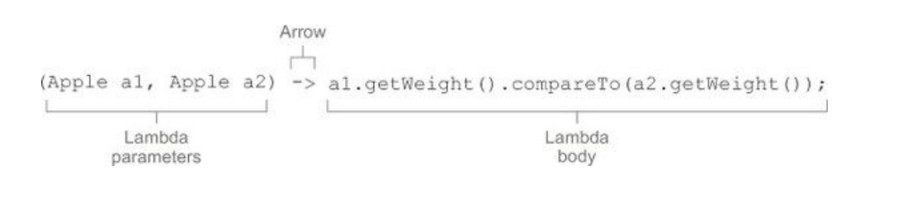
Lambda Expression Formula
A list of parameters— In this case it mirrors the parameters of the compare method of a Comparator—two Apples.
An arrow— The arrow -> separates the list of parameters from the body of the lambda
The body of the lambda— Compare two Apples using their weights. The expression is considered the lambda’s return value.
The basic syntax of a lambda is either
(parameters) -> expression
(parameters) -> { statements; }
Note: https://docs.oracle.com/javase/tutorial/java/nutsandbolts/expressions.html

Slide 14
List of example lambdas with examples of use cases
Use case | Examples of lambdas
A boolean expression | (List<String> list) -> list.isEmpty()
Creating objects | () -> new Apple(10)
Consuming from an object | (Apple a) -> { System.out.println(a.getWeight()); }
Select/extract from an object | (String s) -> s.length()
Combine two values | (int a, int b) -> a * b
Compare two objects | (Apple a1, Apple a2) -> a1.getWeight().compareTo(a2.getWeight())

Slide 15
Where and how to use lambdas
Functional Interface:
A functional interface is an interface that specifies exactly one abstract method, such as Comparator and Runnable.
Ex:
Note: An interface is still a functional interface if it has many default methods as long as it specifies only one abstract method.
@FunctionalInterface public interface Predicate<T> {
boolean test(T t);
}
@FunctionalInterface public interface Comparator<T> {
int compare(T o1, T o2);
boolean equals(Object obj);
default Comparator<T> reversed() { return Collections.reverseOrder(this); }
}

Slide 16
Where and how to use lambdas
Functional interfaces are useful because the signature of the abstract method can describe the signature of a lambda expression. The signature of the abstract method of a functional interface is called a function descriptor.
Lambda expressions let you provide the implementation of the abstract method of a functional interface directly inline and treat the whole expression as an instance of a functional interface
Functional interface | Function descriptor
Predicate<T> | T -> boolean
Consumer<T> | T -> void

Slide 17
Demo
[ { "name" : "Staff1", "birthYear" : 1990, "position" : "SE", "salary" : 1500, "skills" : [ "java", "python" ] }, { "name" : "Staff2", "birthYear" : 1981, "position" : "SSE", "salary" : 2500, "skills" : [ "java", "php" ] }, { "name" : "Staff3", "birthYear" : 1987, "position" : "SSE", "salary" : 3800, "skills" : [ "java", "css" ] }, { "name" : "Staff4", "birthYear" : 1978, "position" : "SA", "salary" : 7500, "skills" : [ "java", "sql" ] }, { "name" : "Staff5", "birthYear" : 1983, "position" : "SSE", "salary" : 4500, "skills" : [ ".net", "javascript" ] } ]

Slide 18
Demo
@FunctionalInterface public interface FilterService<T> { boolean test(T t); }
public class StaffStream<T> { private List<T> staffs; public StaffStream(List<T> staffs){ this.staffs = staffs; } public List<T> filter(FilterService<T> filter) { for(Iterator<T> iter = staffs.listIterator(); iter.hasNext(); ) { T staff = iter.next(); if (!filter.test(staff)) { iter.remove(); } } return staffs; } }

Slide 19
Demo
public class FuncInterMain {
public static void main(String[] args) { List<Staff> staffList = JsonUtils.getAllStaffs(); System.out.println("**** Lambda Expression ******"); List<Staff> filterStaff = new StaffStream<Staff>(staffList) .filter((d) -> d.getSkills().contains("java") && d.getPosition().equals("SSE")); for (Staff staff: filterStaff) { System.out.println(staff.getFullName()); } System.out.println("*************************"); System.out.println(""); System.out.println("*******Java 6 & 7 ***********"); List<Staff> trafilterStaff = new StaffStream<Staff>(staffList) .filter(new FilterService<Staff>() { @Override public boolean test(Staff staff) { if (staff.getSkills().contains("java") && staff.getPosition().equals("SSE")) { return true; } return false; } }); for (Staff staff: trafilterStaff) { System.out.println(staff.getFullName()); } System.out.println("*************************"); } }
Lambda Expession
(d) -> d.getSkills().contains("java") && d.getPosition().equals("SSE")

Slide 20
Pros and Cons?
Advantage:
Write cleaner and less code?
Disadvantage:
Hard to debug?
Low performance?

Slide 21
Resources
Books:
Java 8 in action
Reference Link:
Oracle lesson: https://docs.oracle.com/javase/tutorial/java/javaOO/lambdaexpressions.html
Demo: https://github.com/minhntk/jdk8.git

